Slide 1
Chapter 10
Launching the Nation
(1789-1800)

Slide 2
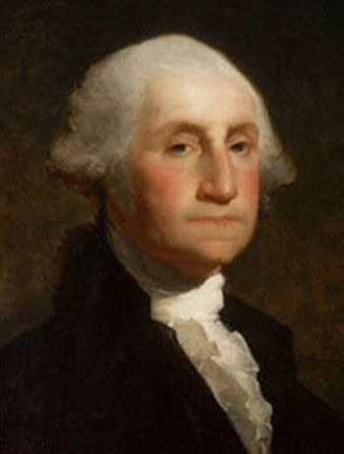
Section 1: Laying the Foundations of Government
George Washington thought he might be poor President
  Old age
  Lack of political experience
Jan, 1789
  States send electors to choose first President
    These delegates formed the electoral college
      They would represent the popular votes in their state, but could choose someone else
    George Washington elected President, John Adams Vice-President

Slide 3
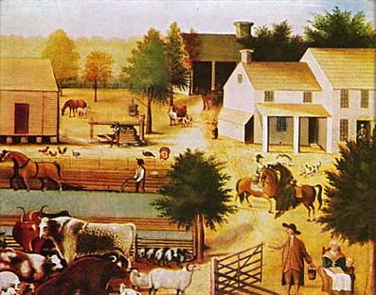
Life in the New republic
1790
  USA has 4 million people
    Most lived in countryside and worked on farms
      Wanted fair tax laws and right to settle frontier
    Others worked in towns
      Wanted fair trade laws and protection from foreign competition
    Only NYC and Philly had more than 25,000 people

Slide 4
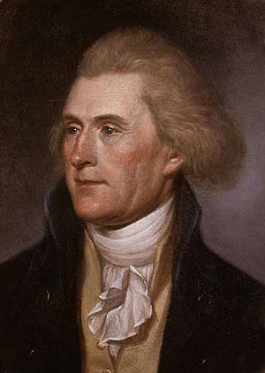
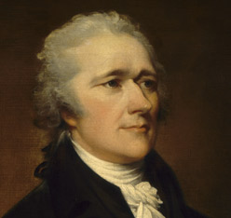
Setting Precedents
New leaders had to establish many PRECEDENTS
  Precedent – an action or a decision that serves as an example for later generations
    Precedent #1 – planning executive branch
      New executive departments: State, War, etc.
        Sec. of Treasury: Alexander Hamilton
        Sec. of State: Thomas Jefferson
    Precedent #2 – cabinet
      Washington had people advising him – “cabinet” common by 1792

Slide 5
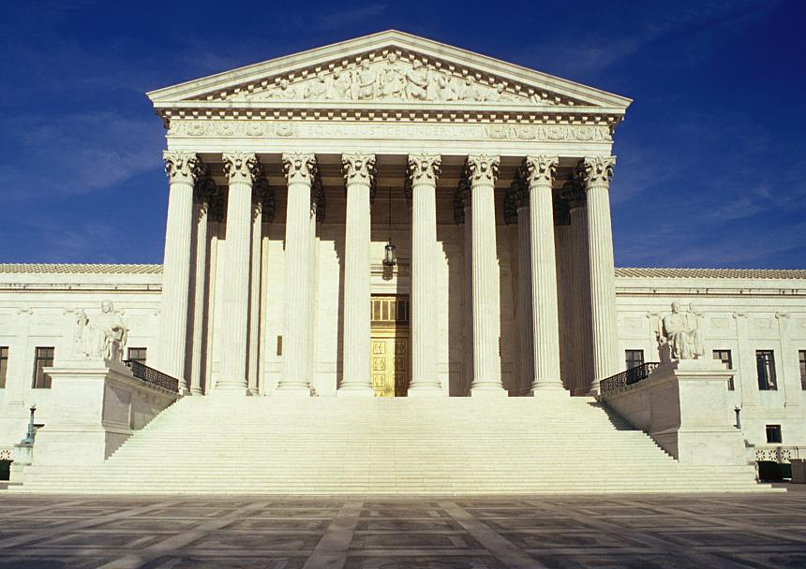
A Push for change
    Precedent #3 – organizing Judicial Branch
      JUDICIARY ACT of 1789
        Created a federal court system with 3 levels
          District courts lowest level
          Above that Court of Appeals
          At top Supreme Court
            Six justices
            John Jay – first Chief Justice of the Supreme Court

Slide 6
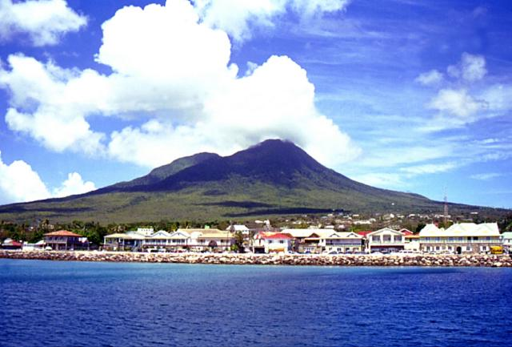
Section 2: Hamilton and national finance
Settling the Debt
  Hamilton
    Born on Nevis (Caribbean)
    Business-minded
    Sec. of Treasury
      Pay off national debt
        Money owed by U. S. to lender
      U. S. also owes money to citizens
        Some in form of bonds
          Certificates that represent money owed

Slide 7
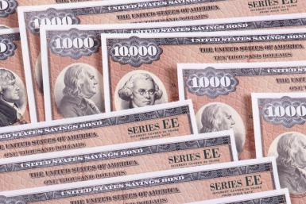
Settling the Debt (continued)
Bonds
  Gov. promised to buy back bonds with interest but didn’t quite work out
    People sold bonds for less than value to SPECULATORS
      People who buy items at low prices in the hope that the value will rise
    Hamilton wanted to pay all debt immediately—secure country’s financial future
      JEFFERSON against idea
        Hated idea of speculators keeping money
        Lost out in debate

Slide 8
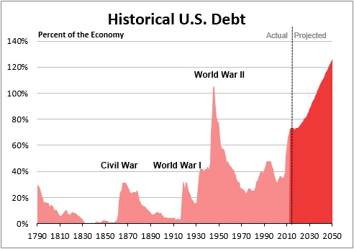
Settling the debt (continued)
States’ Debt
  Hamilton
    Pay most of debt immediately
      Free up states to focus on business and trade
      Southern states against idea
        They had little war debt and did not want to help Fed. Gov. pay debt of other states

Slide 9
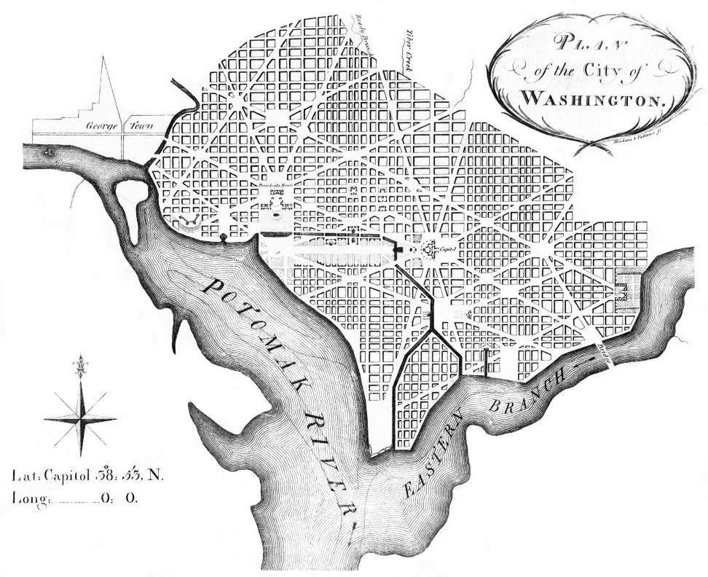
Settling the debt (continued)
Compromise
  Southerners resented capital in N.Y.C.
    Would give North too much power of policy
  Meeting of Hamilton, Jefferson, and Madison
    Southerners would assist with debt plan
    New capital in South to be constructed
      Washington D. C.
      Philadelphia intermediary capital

Slide 10
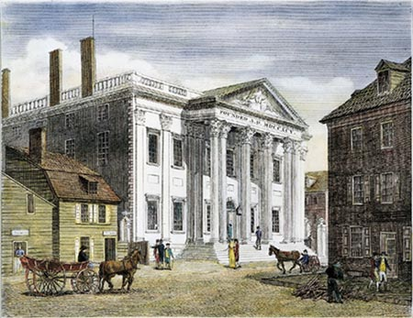
The Debate over the bank
Hamilton
  Start a national bank
    20-year charter
  Create a national mint
  Justified idea with “elastic clause”
    LOOSE CONSTRUCTION view of Constitution
Jefferson
  Worried about bank
  STRICT CONSTRUCTION view
Washington
  Agreed with Hamilton
  BANK OF THE UNITED STATES created

Slide 11
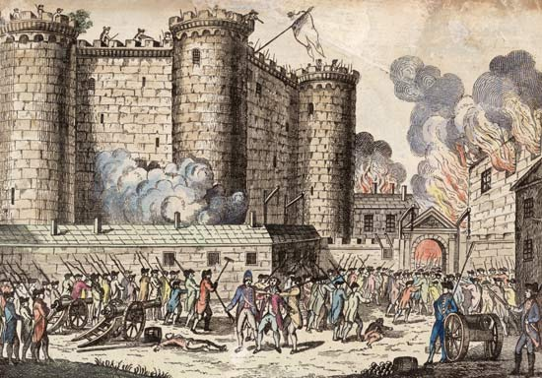
Section 3: troubles abroad
FRENCH REVOLUTION
  Began with storming of Bastille prison (1789)
  Gained support of many Americans
  Other opposed it as it became very radical
U. S. NEUTRALITY PROCLAMATION
  Washington’s view
  U. S. should not take sides with countries at war in Europe

Slide 12
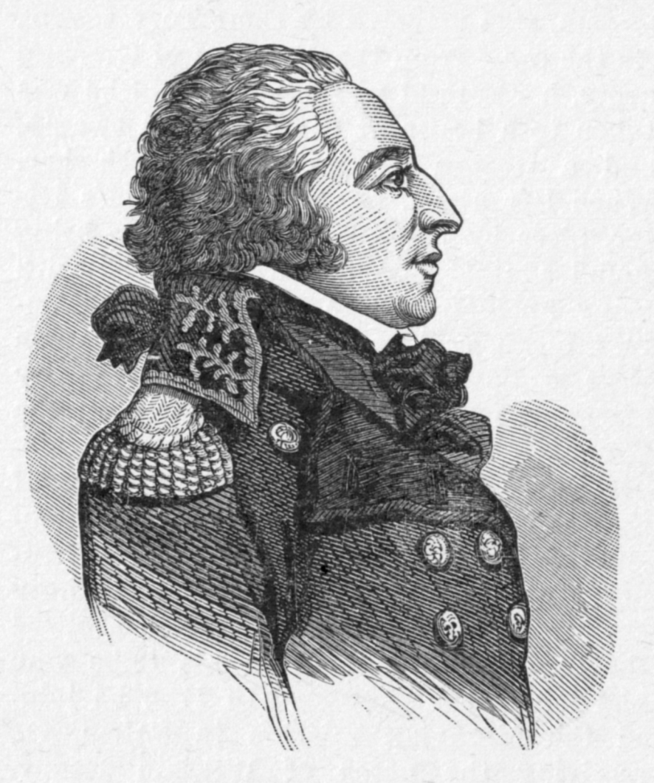
Troubles abroad (cont.)
EDMONG GENET
  French rep. to U. S.
  Known as “Citizen Genet”
  Traveled country seeking support for Revolution
  Found sea captains to command PRIVATEERS
    Private ships allowed by a country to attack its enemies
    Angered Washington, but Genet didn’t care
Jefferson against Genet, but sympathetic to Revolution
  Also worried pro-British Hamilton influencing Washington too much
  Jefferson ended up leaving cabinet in 1793

Slide 13
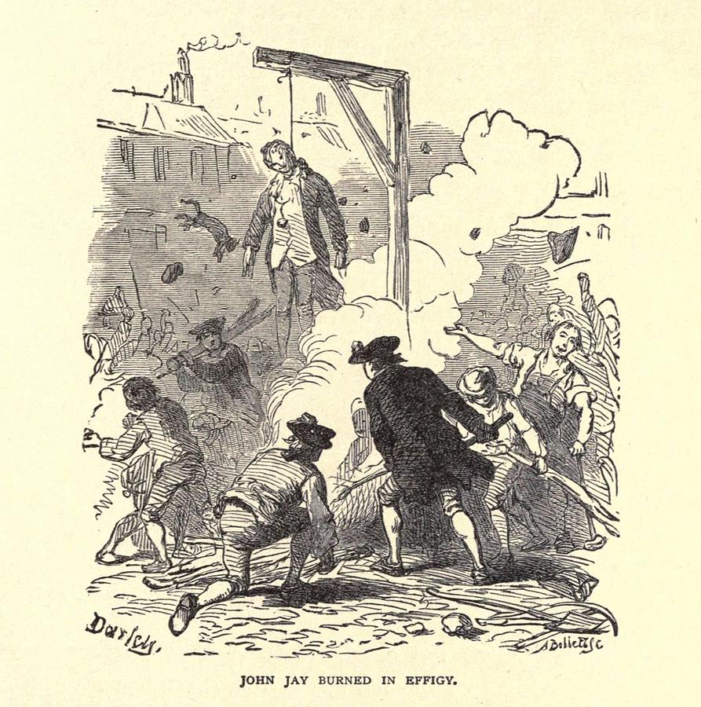
Troubled abroad (cont.)
Jay’s Treaty
  Other issues abroad
    Britain
      Seizing ships carrying food to West Indies, including neutral American ships
      Encouraging Indian uprisings on West. Frontier
        never abandoned frontier forts from TPII
  JOHN JAY sent to Britain
    Britain did not want another war…yet

Slide 14
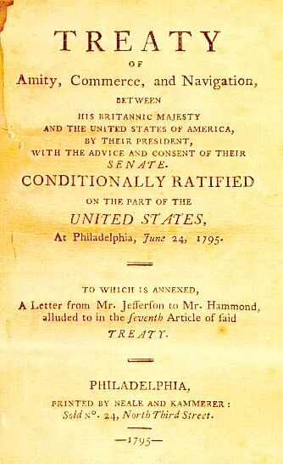
Troubles abroad (cont.)
Jay’s Treaty
  Agreement reached in 1794
    British will pay damages for seized Am. Ships
    Will abandon forts on northwestern frontier
    U. S. would pay pre-Rev. War debts
  Criticisms of Treaty
    Didn’t prevent Britain from capturing large ships or supporting Indians
    Did not make Britain return freed slaves from Rev. War
  Washington felt it was best deal
    Congress approved Treaty

Slide 15
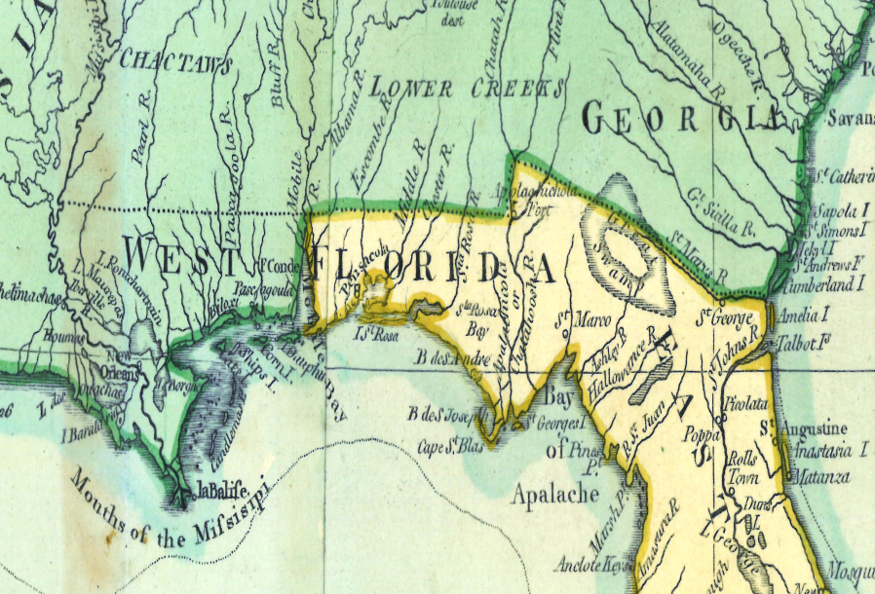
Troubles abroad (cont.)
Pinckney’s Treaty
  Problems in Spanish Florida & Louisiana
    Border dispute in Florida
      Spain closes New Orleans to U. S. trade
          All good down Mississippi had to pass through it!
          Separated Western frontier from outside world
  THOMAS PINCKNEY
    U. S. Ambassador chosen by Washington
    Asked Spain to re-open port
    Requested RIGHT OF DEPOSIT
      American boats could transfer good at New Orleans with a fee

Slide 16
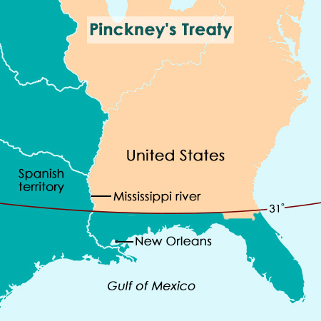
Troubles abroad (cont.)
Pinckney’s Treaty
  Spanish Minister Manuel de Godoy
    Tried to delay reaching an agreement
      …but worried that U. S. would ally with Britain
    Signed PINCKNEY’S TREATY in 1795
      Spain would change Florida border
      Reopened port at New Orleans to American ships and gave right of deposit
      Opened frontier to further expansion

